Slide 1
Artificial intelligence for plant disease detection
식물 질병 탐지를 위한 인공지능

Slide 2
Introduction
Background
Agricultural tasks are repetitive and laborious
AI can solve this task
Goals
Plant disease detection using AI

Slide 3
Python basic
What is python:
A programming language. Other programming language: C, C#, C++, PHP
Python is for data science
It is easy to learn and supported by many communities

Slide 4
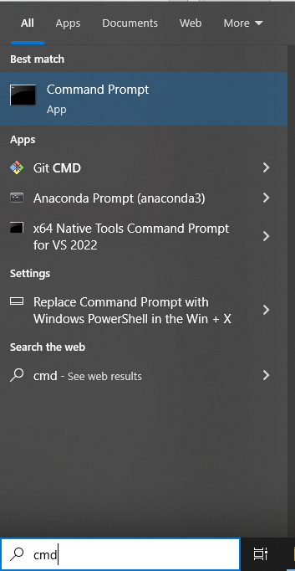
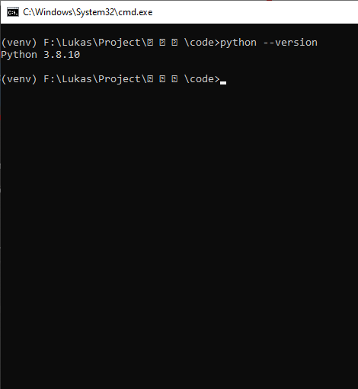
Python basic
Check python version and Installing python
2. click
3. type
4. result
1. type

Slide 5
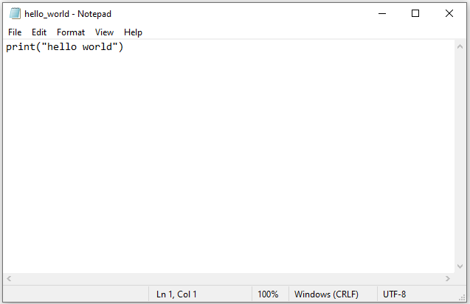
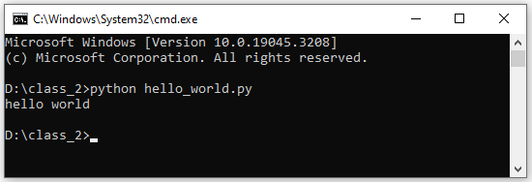
Python basic
Making and running python file

Slide 6
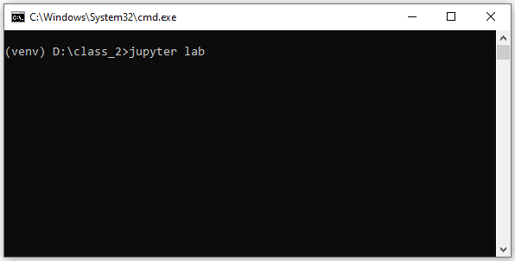
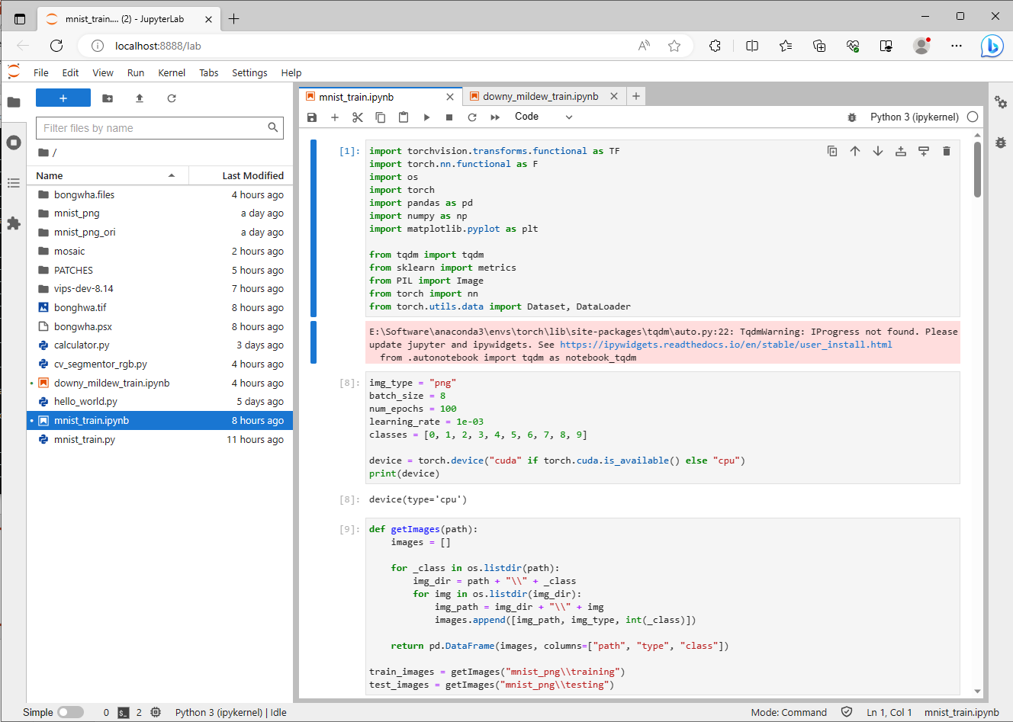
Python basic
Make calculator application
Goal:
accept input from user and do addition, subtraction, multiplication and division
2. Jupyter opened
1. type: “jupyter lab”

Slide 7
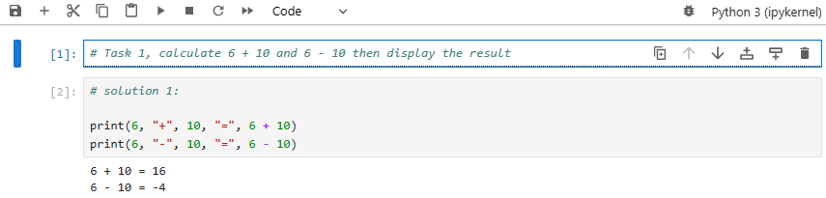
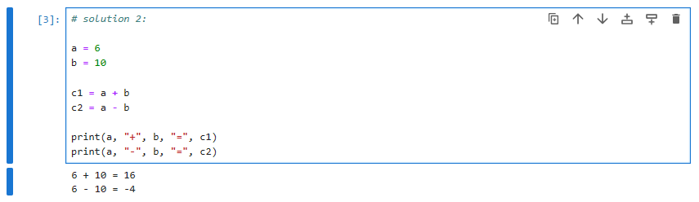
Python basic
Variables and math operation

Slide 8
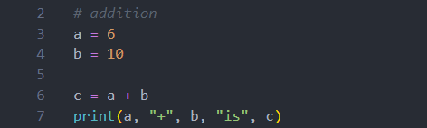
Python basic
Variables and math operation
Code:
Variable
Display the result in Terminal

Slide 9
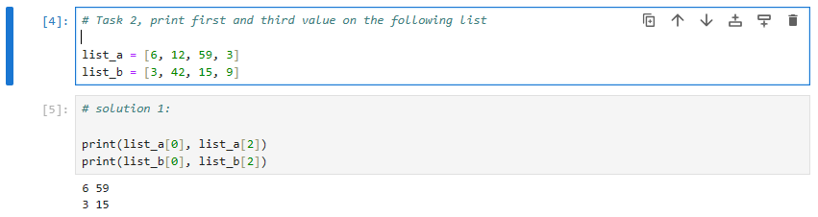
Python basic
List: variables that has multiple values

Slide 10
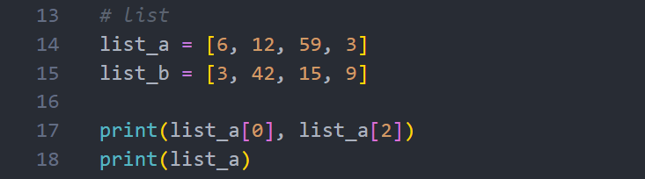
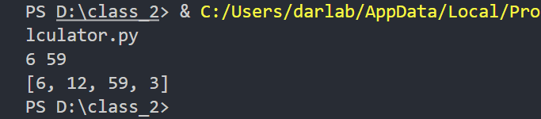
Python basic
List: variables that has multiple values
Result:

Slide 11
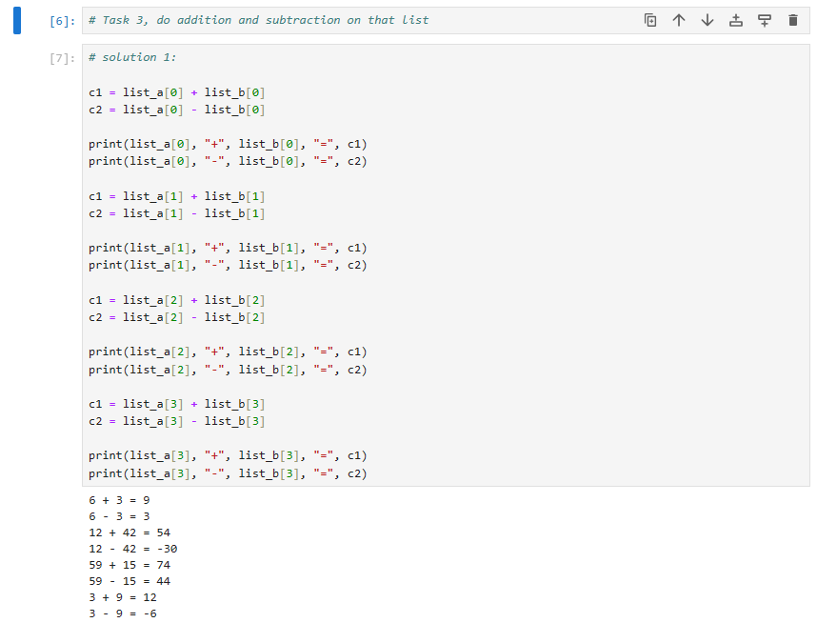
Python basic
Function

Slide 12
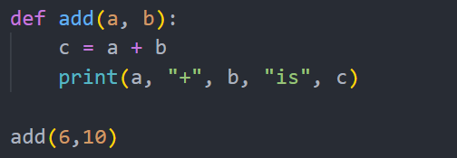
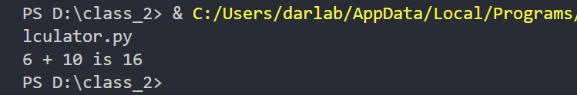
Python basic
function name
Function
def
arguments
:
content
making function
Tab
using function
Result:

Slide 13
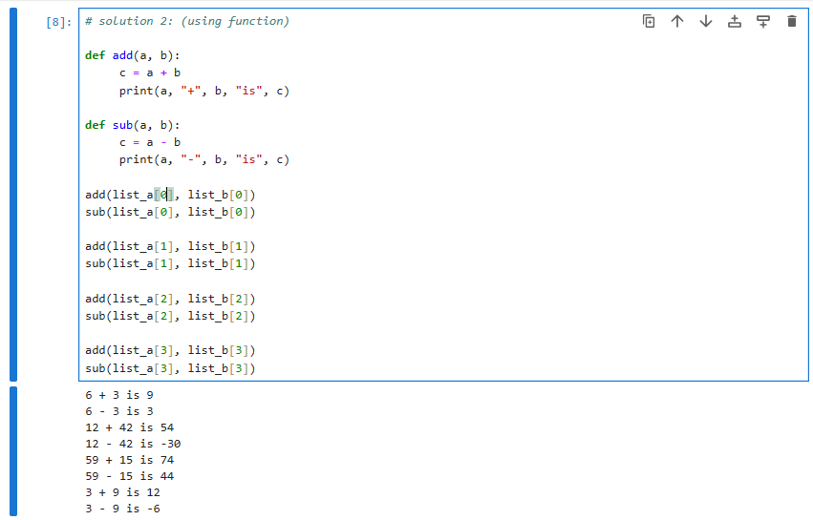
Python basic
Function

Slide 14
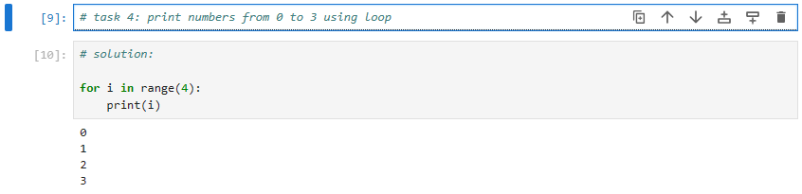
Python basic
Loop

Slide 15
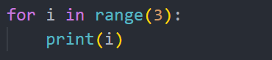
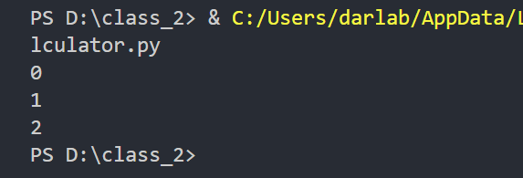
Python basic
Loop
loop variable
number of loop
for
in range
:
content
Tab
Result:

Slide 16
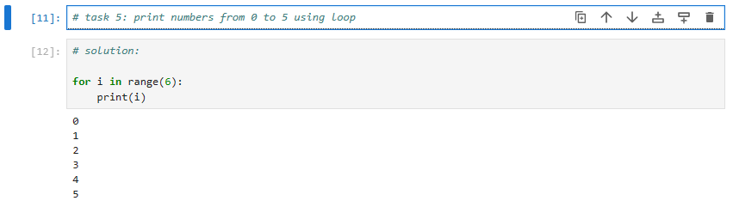
Python basic
Loop

Slide 17
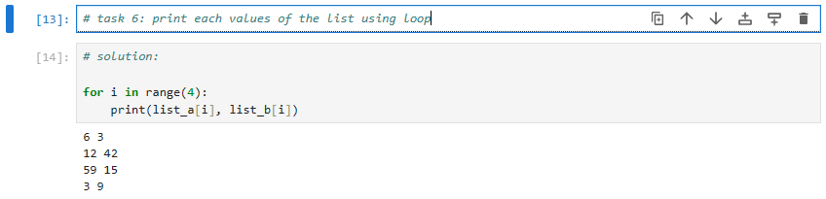
Python basic
Loop

Slide 18
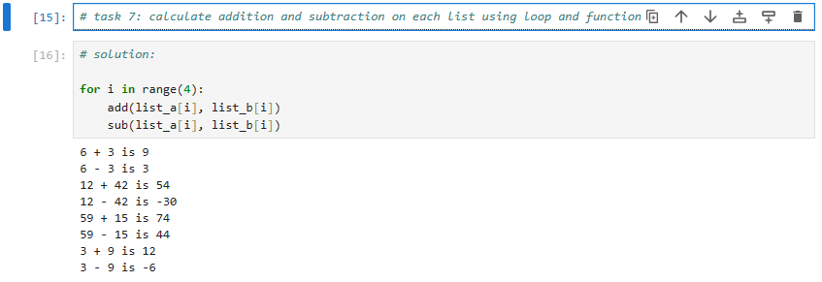
Python basic
Loop

Slide 19
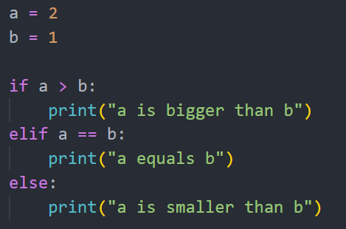
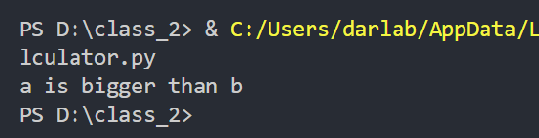
Python basic
condition 1
condition 2
Condition
if
elif
else
Result:

Slide 20
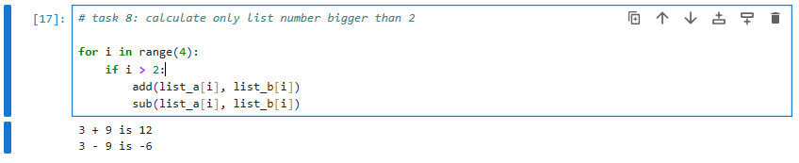
Python basic
Loop

Slide 21
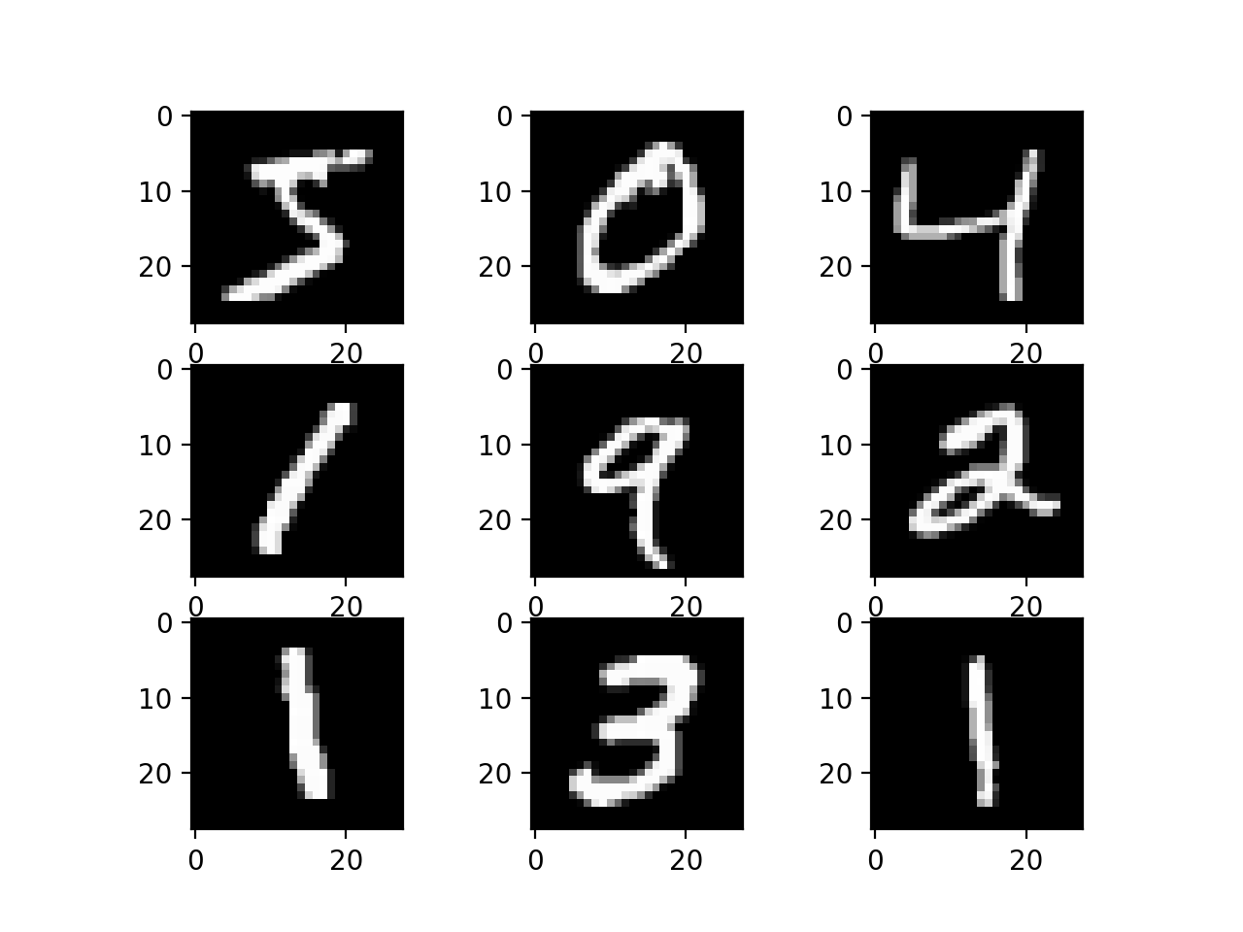
Machine learning basic
MNIST dataset
Hand-writing of numbers from 0 to 9 by many people
The goal is to recognize each of the picture

Slide 22
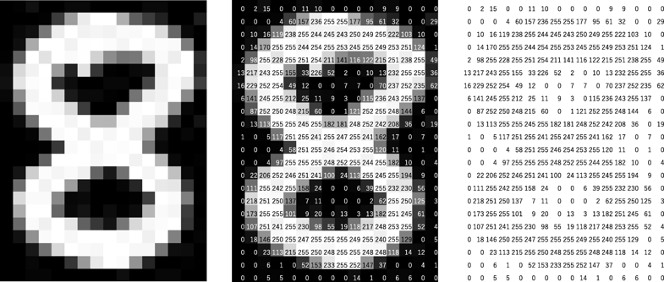
Machine learning basic
MNIST dataset
Easy for human hard for computer
Human see
Computer see

Slide 23
Machine learning basic
MNIST dataset
We can make artificial intelligence to learn from this dataset and recognize other people hand-writing
We can imagine AI as a child. At first, it knows nothing. But if we teach them with data or pictures, eventually it can understand.

Slide 24


Machine learning basic
untrained AI model
AI model with knowledge
Training
Process
known dataset
training
AI model with knowledge
Usage
Process
unknown dataset
known dataset
prediction

Slide 25
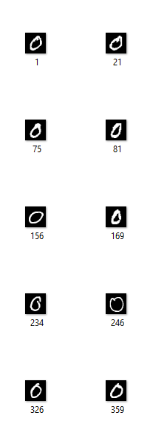
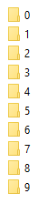
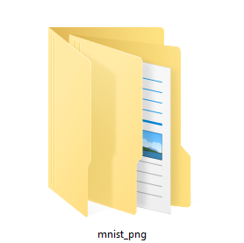
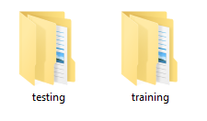
Machine learning basic
Check dataset

Slide 26
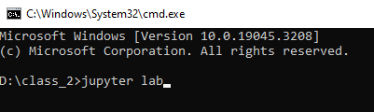
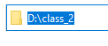
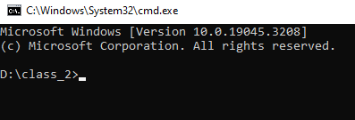
Machine learning basic
3. type: “jupyter lab”
Start coding
Open Jupyter lab
1. type: “cmd”
4. Jupyter opened
2. Terminal opened

Slide 27
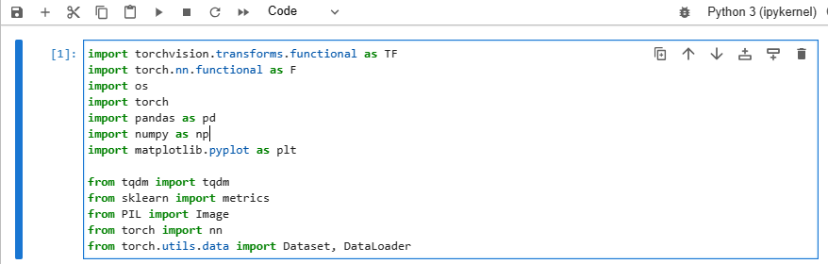
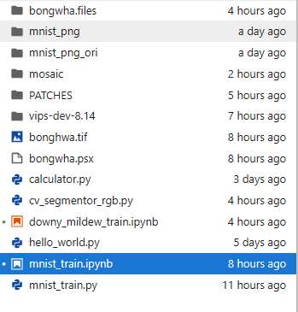
Machine learning basic
3. click
2. import library
Start coding
Import library
4. result
1. double click

Slide 28
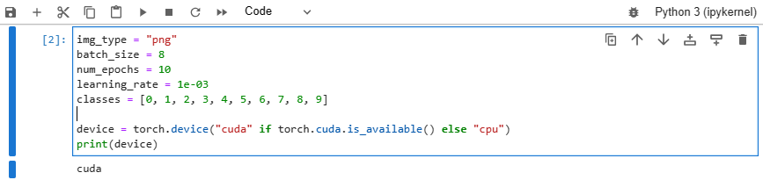
Machine learning basic
Start coding
Set parameters
1. click
2. result

Slide 29
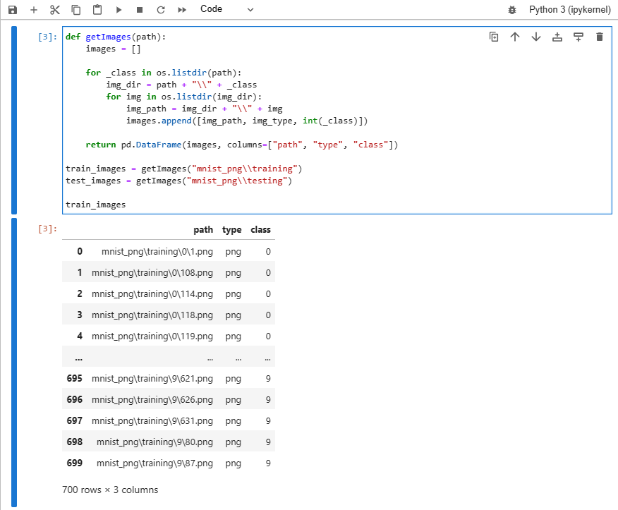
Machine learning basic
1. click
Start coding
Load images
2. result

Slide 30
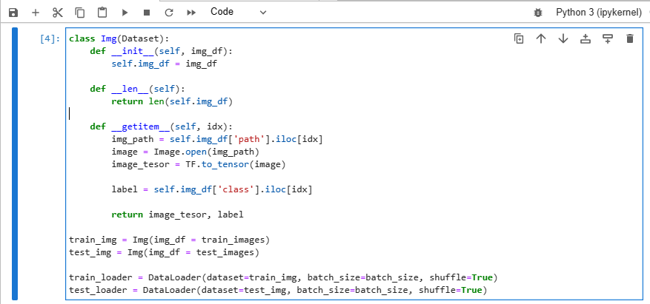
Machine learning basic
1. click
Start coding
Prepare images

Slide 31
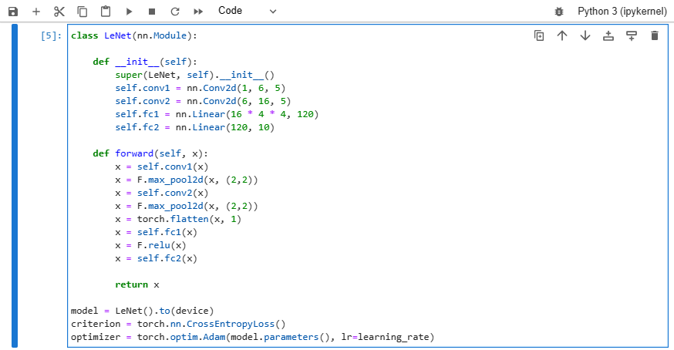
Machine learning basic
1. click
Start coding
Make LeNet

Slide 32
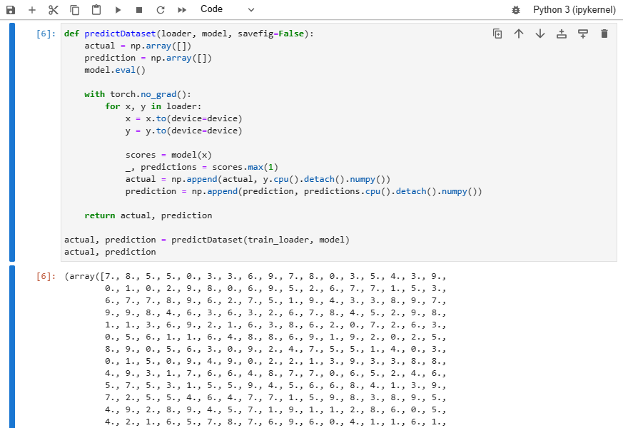
Machine learning basic
1. click
Start coding
LeNet prediction before training
2. result

Slide 33
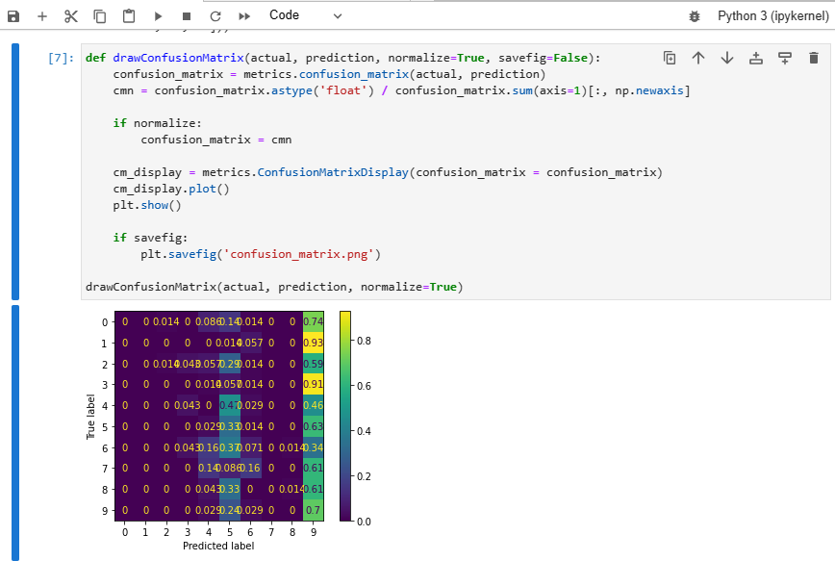
Machine learning basic
1. click
Start coding
LeNet prediction before training (visualization)
2. result

Slide 34
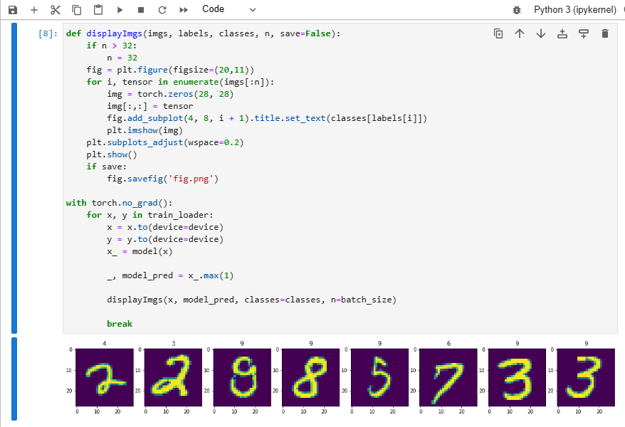
Machine learning basic
1. click
Start coding
LeNet prediction before training (visualization 2)
AI model prediction
data

Slide 35
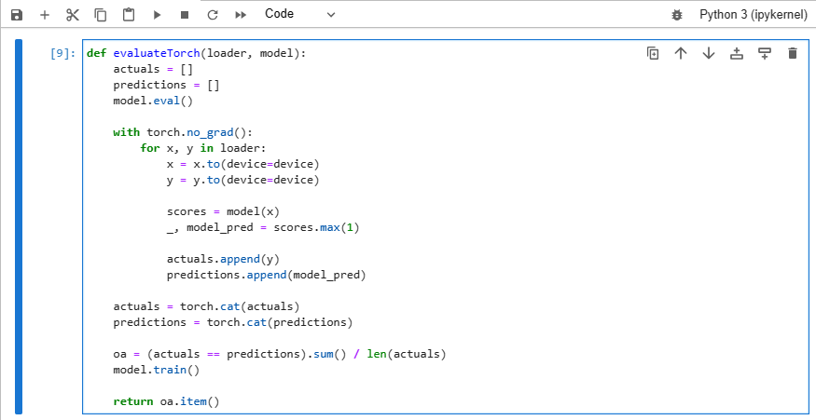
Machine learning basic
1. click
Start coding
Prepare for training

Slide 36
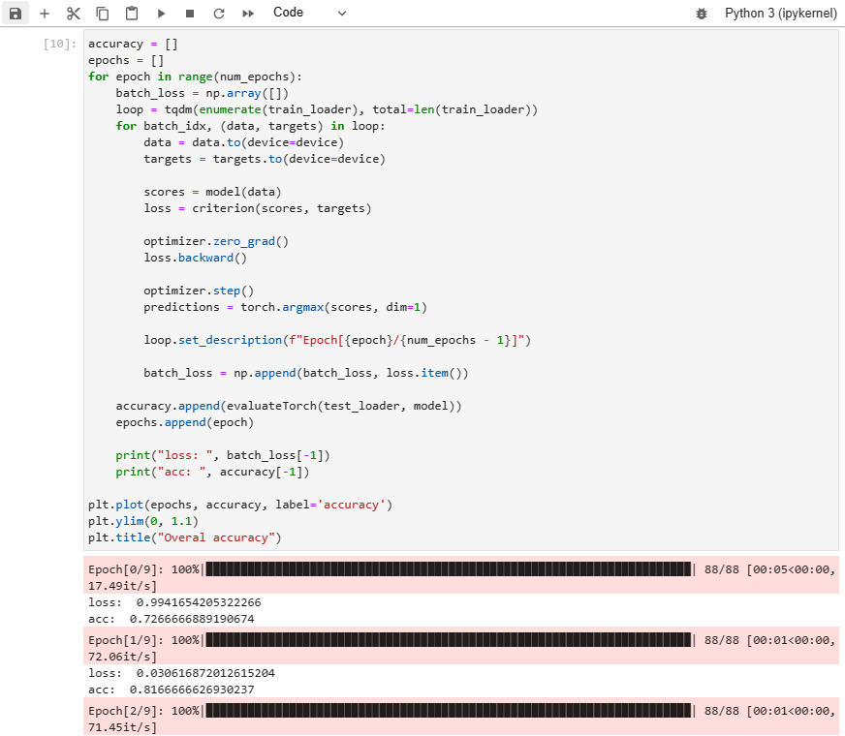
Machine learning basic
1. click
Start coding
Training
Accuracy 1
Accuracy 2

Slide 37
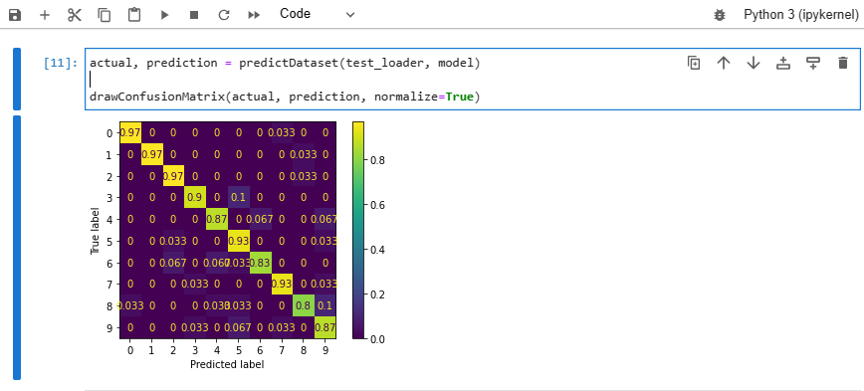
Machine learning basic
1. click
Start coding
LeNet prediction after training

Slide 38
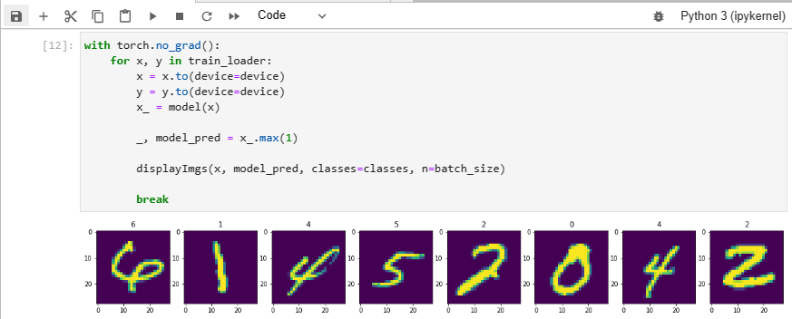
Machine learning basic
Start coding
LeNet prediction after training 2
1. click
AI model prediction
data

Slide 39
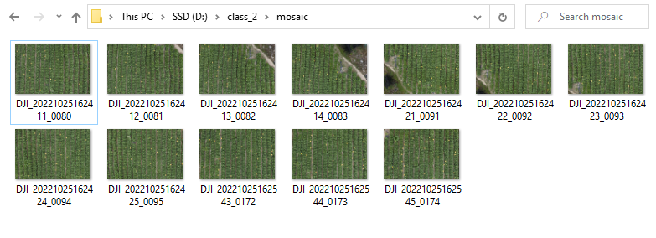
Drone dataset
Mosaicking: A process of combining multiple photos into one, big photo
Check the photos

Slide 40
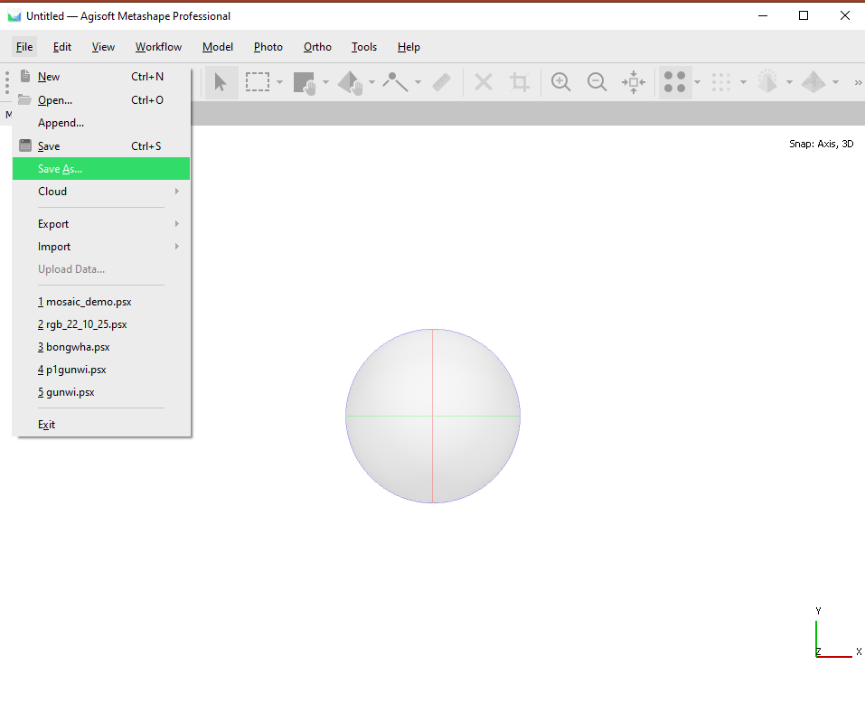
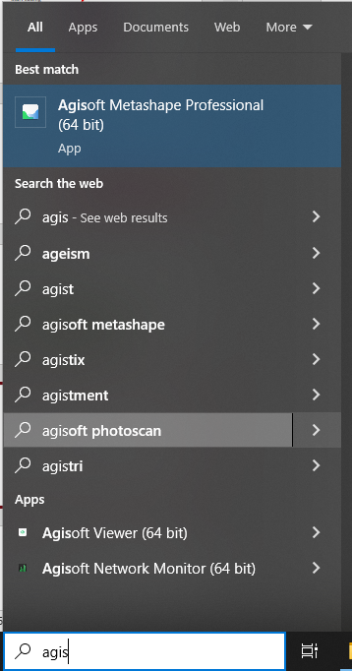
Drone dataset
Mosaicking
Open Agisoft
2. click
3. click
1. type

Slide 41

Drone dataset
Mosaicking
Save project
1. type
2. click

Slide 42


Drone dataset
2. select
Mosaicking
Load photos
1. click
3. click

Slide 43



Drone dataset
Mosaicking
Align photos
2. click
1. click
3. result

Slide 44



Drone dataset
2. click
Mosaicking
Build dense cloud
1. click
3. click

Slide 45

Drone dataset
Mosaicking
Build dense cloud
result

Slide 46



Drone dataset
Mosaicking
Build mesh
2. click
1. click
3. click

Slide 47

Drone dataset
Mosaicking
Build mesh
result

Slide 48
Drone dataset
Mosaicking
Build mesh
2. click
1. click
3. click

Slide 49


Drone dataset
Mosaicking
Build orthomosaic
1. click
2. click

Slide 50


Drone dataset
1. click
Mosaicking
Build orthomosaic
result

Slide 51



Drone dataset
Diseased samples
1. click
2. click
diseased

Slide 52


Drone dataset
3. type: “python cv_segmentor_rgb.py”
Making dataset
1. type: “cmd”
2. Terminal opened

Slide 53

Drone dataset
Making dataset
Diseased: Press ‘d’ -> click
Background: Press ‘b’ -> click
Healthy: Press ‘h’ -> click

Slide 54


Drone dataset
Making dataset
1. End result
2. Press ‘s’
3. result
4. close, ctrl + c

Slide 55

Drone dataset
Making dataset

Slide 56
Drone dataset
3. type: “jupyter lab”
Start coding
Open Jupyter lab
1. type: “cmd”
4. Jupyter opened
2. Terminal opened

Slide 57


Drone dataset
3. click
2. import library
Start coding
Import library
4. result
1. double click

Slide 58

Drone dataset
Start coding
Set parameters
1. click
2. result

Slide 59

Drone dataset
1. click
Start coding
Load images
2. result

Slide 60

Drone dataset
1. click
Start coding
Prepare images

Slide 61

Drone dataset
1. click
Start coding
download InceptionNet

Slide 62

Drone dataset
1. click
Start coding
InceptionNet prediction before training
2. result

Slide 63

Drone dataset
1. click
Start coding
InceptionNet prediction before training (visualization)
2. result

Slide 64

Drone dataset
1. click
Start coding
InceptionNet prediction before training (visualization 2)
P: Prediction
T: Truth
data

Slide 65

Drone dataset
1. click
Start coding
Prepare for training

Slide 66

Drone dataset
1. click
Start coding
Training
Accuracy 1
Accuracy 2

Slide 67

Drone dataset
Start coding
InceptionNet prediction after training
1. click

Slide 68

Drone dataset
1. click
Start coding
InceptionNet prediction after training 2
AI model prediction
data

